Slide 1
How to be Culturally Responsive in Your Practice
CODs & Treatment Conference, Yakima, WA
October 8, 2024
Presenters:
Laura Cooley (she/her), MA, Continuing Education Specialist, Washington State
and
Sean Mahoney (he/him), PWS, CRM, Mental Health and
Addiction Association of Oregon

Slide 2
Learning Goals
1. Increase awareness of the importance of being culturally responsive in behavioral health practice as a means of improving quality of services and helping reduce health disparities
2. Identify opportunities for integrating CLAS (Culturally and Linguistically Appropriate Services) standards in your practice and how this integration can satisfy related federal and state guidelines
3. Become familiar with tools that can be used to incorporate CLAS standards in your practice or agency

Slide 3

Principles of Cultural Humility
Coming from a place of knowing that we don’t (or may not) know
Being able to accept our own limitations
Encouraged to be curious
Notes:
In much the same way that we’re constantly adapting in our efforts to be more culturally responsive – and as part of the ongoing learning that must happen with cultural humility– I think of ways we can all be conscious of differently abled people. For instance, the language board we just saw from New York is very helpful for someone whose first language may not be English. What is a person walks in the clinic and their main language is sign? Perhaps we’d need to think about adding signage that speaks to how deaf interpretation is available.

Slide 4
Acknowledgements
This workshop draws in large part on a CLAS training of trainers developed in 2024 by the Addiction Technology Transfer Center (ATTC) Network for a training on: Culturally and Linguistically Appropriate Services (CLAS) Standards: Supporting Culturally Responsive Services in Behavioral Health Settings.
The opinions expressed herein are our own and do not reflect the official position of either the ATTC Network or the Department of Health and Human Services (DHHS), SAMHSA. No official support or endorsement of DHHS, SAMHSA, for the opinions described in this presentation is intended or should be inferred.
Any implicit bias you may detect is of our own making.

Slide 5
Acknowledgement & Disclosure
The CLAS training curriculum developed in 2024 by the Addiction Technology Transfer Center (ATTC) Network was produced under a cooperative agreement from the Substance Abuse and Mental Health Services Administration (SAMHSA).
No Conflicts of Interest to Disclose.

Slide 6
Where Could We Be Better?
Accessibility?
Language?
Inclusivity?
Cultural Sensitivity?

Slide 7
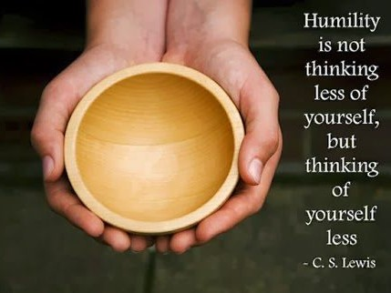

Slide 8
When It Is Better
Increased Engagement
Culturally Specific Treatment Works
Fewer Misdiagnoses
Less Participants Falling Through The Gaps
More People Connected to Services!

Slide 9
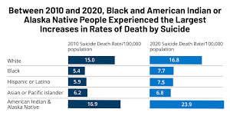
Source: Kaiser Family Foundation. Accessed September 22, 2022 at:
https://www.kff.org/mental-health/issue-brief/five-key-findings-on-mental-health-and-substance-use-disorders-by-race-ethnicity/
Five Key Findings on Mental Health and Substance Use Disorders by Race/Ethnicity. Nirmita Panchal, Heather Saunders, and Nambi Ndugga

Slide 10
Why We Should Care About CLAS?
Another reason to implement CLAS standards:
To improve the quality of services provided to all individuals
Better health outcomes

Slide 11
Language Action Plan from SAMHSA
Calls on agencies/its financial award recipients to: Understand and comply with their obligations under
civil rights statutes and regulations enforced by HHS that require them to provide language assistance services.
Ensure you meet Federal and State Require-ments
Source: Language Action Plan, 2024. U.S. Department of Health and Human Services
Substance Abuse and Mental Health Services Administration
Office of Behavioral Health Equity and Office of Communications

Slide 12



CLAS Standards: Engagement, Continuous Improvement, and Accountability

Slide 13
Bringing CLAS into Your Practice
Identify opportunities for infusing CLAS into your practice
Become familiar with tools that can be used to incorporate CLAS standards in your practice or agency

Slide 14
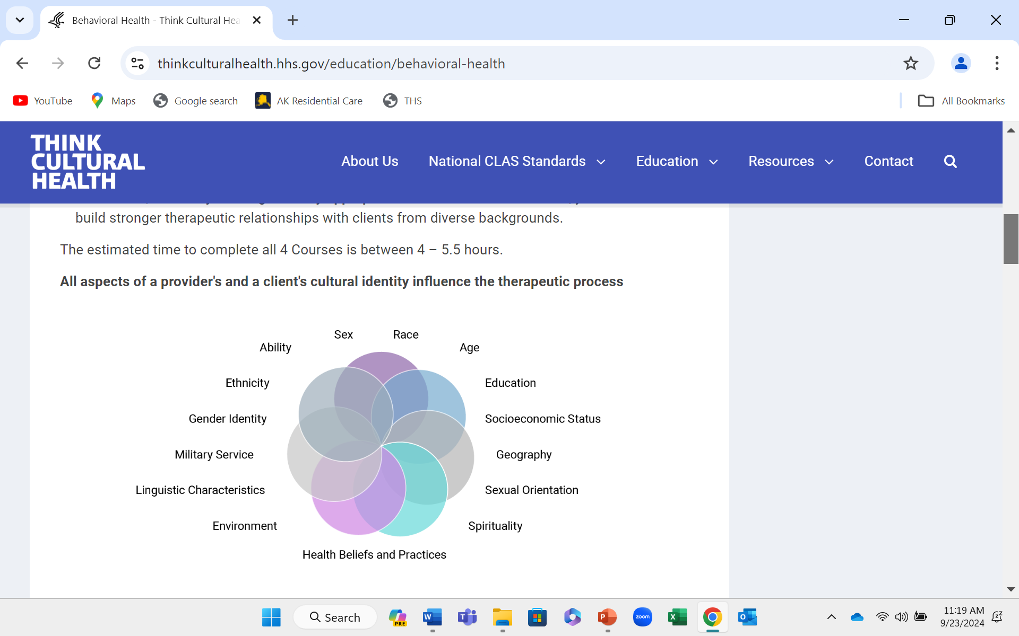
Source: Think Cultural Website, HHS: https://thinkculturalhealth.hhs.gov/education/behavioral-health

Slide 15
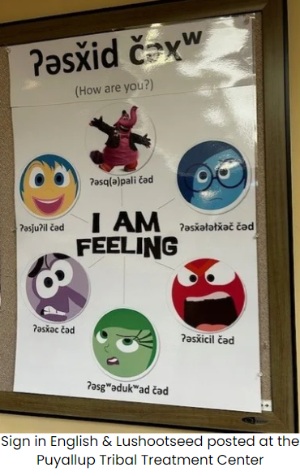

Notes:
In much the same way that we’re constantly adapting in our efforts to be more culturally responsive – and as part of the ongoing learning that must happen with cultural humility– I think of ways we can all be conscious of differently abled people. For instance, the language board we just saw from New York is very helpful for someone whose first language may not be English. What if a person walks in the clinic and their main language is sign? Perhaps we’d need to think about adding signage that speaks to how deaf interpretation is available. Or maybe their first language is Lushootseed and even though they are conversant in English, as an elder perhaps they would prefer to just point to how they are feeling.

Slide 16

CLAS Standards 9-15
Putting CLAS into Practice

Slide 17
4
Engagement, Continuous Improvement, and Accountability (Standards 9-15, starting with 9-11)
9
Establish culturally and linguistically appropriate goals, policies, and management accountability and infuse them throughout the organization’s planning and operations.
Conduct ongoing assessments of the organization’s CLAS-related activities and integrate CLAS-related measures into measurement and continuous quality improvement activities.
Collect and maintain accurate and reliable demographic data to monitor and evaluate the impact of CLAS on health equity and outcomes and to inform service delivery.
10
11
Notes:
When considering any type of change or integration of new programs, protocols or organizational enhancements, it is imperative that measure and processes are identified for monitoring implementation strategies and opportunities to adapt along the way. THIS IS AN ONGOING PROCESS. Not a ONCE AND DONE kind of thing. (CONNECTS TO NIATX in that you will want to know the baseline and consider what you are wanting to measure right?
Establish culturally and linguistically appropriate goals, policies, and management accountability, and infuse them throughout the organization’s planning and operations. Ensure that organizations review their policies, procedural protocols and manuals, and identify means or personnel responsible for reviewing and updating processes to be inclusive of culturally informed and linguistically appropriate standards. Organizations can form in-service committees to review governance policies and protocols on all operations levels to ensure that they are inclusive, culturally and linguistically appropriate. i.e., mission statement, hiring practices, annual cultural training for all staff, etc. (IN YOUR ORGANIZ. WHO DOES THIS? This could fall to a DEI Committee, or a self-styles group, or some group involving HR) ??
Conduct ongoing assessments of the organization’s CLAS-related activities and integrate CLAS-related measures into measurement and continuous quality improvement activities. Evaluation is key to successful implementation and sustainability of steps to build equity in service provision. Three general levels of evaluation can be used to organize an approach to evaluating successful outcomes of implementation.
Formative evaluation involves examining the problem or situation for which a program is being created and projecting the effectiveness of the program components based on the goals and objectives of the program itself.
Process evaluation involves examining the situation, events, problems, people and interactions as a program unfolds. Process evaluation occurs during program development, program implementation and data collection. Process evaluation can be approached in several different manners. Among the methods for process evaluation include:
Program evaluation is the assessment of the effectiveness of a program. It examines the impact of an intervention applied at a given location to a specified population
Collect and maintain accurate and reliable demographic data to monitor and evaluate the impact of CLAS on health equity and outcomes and to inform service delivery. Consistently gather information regarding community demographics and initiate and assess current linkages to cultural and language appropriate ancillary services.

Slide 18
CLAS # 9 (of Engagement, Continuous Improvement, and Accountability)
9
Establish culturally and linguistically appropriate goals, policies, and management accountability and infuse them throughout the organization’s planning and operations.
Notes:
When considering any type of change or integration of new programs, protocols or organizational enhancements, it is imperative that measure and processes are identified for monitoring implementation strategies and opportunities to adapt along the way. THIS IS AN ONGOING PROCESS. Not a ONCE AND DONE kind of thing. (CONNECTS TO NIATX in that you will want to know the baseline and consider what you are wanting to measure right?
Establish culturally and linguistically appropriate goals, policies, and management accountability, and infuse them throughout the organization’s planning and operations. Ensure that organizations review their policies, procedural protocols and manuals, and identify means or personnel responsible for reviewing and updating processes to be inclusive of culturally informed and linguistically appropriate standards. Organizations can form in-service committees to review governance policies and protocols on all operations levels to ensure that they are inclusive, culturally and linguistically appropriate. i.e., mission statement, hiring practices, annual cultural training for all staff, etc. (IN YOUR ORGANIZ. WHO DOES THIS? This could fall to a DEI Committee, or a self-styles group, or some group involving HR) ??
Conduct ongoing assessments of the organization’s CLAS-related activities and integrate CLAS-related measures into measurement and continuous quality improvement activities. Evaluation is key to successful implementation and sustainability of steps to build equity in service provision. Three general levels of evaluation can be used to organize an approach to evaluating successful outcomes of implementation.
Formative evaluation involves examining the problem or situation for which a program is being created and projecting the effectiveness of the program components based on the goals and objectives of the program itself.
Process evaluation involves examining the situation, events, problems, people and interactions as a program unfolds. Process evaluation occurs during program development, program implementation and data collection. Process evaluation can be approached in several different manners. Among the methods for process evaluation include:
Program evaluation is the assessment of the effectiveness of a program. It examines the impact of an intervention applied at a given location to a specified population
Collect and maintain accurate and reliable demographic data to monitor and evaluate the impact of CLAS on health equity and outcomes and to inform service delivery. Consistently gather information regarding community demographics and initiate and assess current linkages to cultural and language appropriate ancillary services.

Slide 19
CLAS #10: Assessments
Conduct ongoing assessments of the organization’s CLAS-related activities
and integrate CLAS-related measures into measurement and continuous quality improvement activities.
Notes:
When considering any type of change or integration of new programs, protocols or organizational enhancements, it is imperative that measure and processes are identified for monitoring implementation strategies and opportunities to adapt along the way. THIS IS AN ONGOING PROCESS. Not a ONCE AND DONE kind of thing. (CONNECTS TO NIATX in that you will want to know the baseline and consider what you are wanting to measure right?
Establish culturally and linguistically appropriate goals, policies, and management accountability, and infuse them throughout the organization’s planning and operations. Ensure that organizations review their policies, procedural protocols and manuals, and identify means or personnel responsible for reviewing and updating processes to be inclusive of culturally informed and linguistically appropriate standards. Organizations can form in-service committees to review governance policies and protocols on all operations levels to ensure that they are inclusive, culturally and linguistically appropriate. i.e., mission statement, hiring practices, annual cultural training for all staff, etc. (IN YOUR ORGANIZ. WHO DOES THIS? This could fall to a DEI Committee, or a self-styles group, or some group involving HR) ??
Conduct ongoing assessments of the organization’s CLAS-related activities and integrate CLAS-related measures into measurement and continuous quality improvement activities. Evaluation is key to successful implementation and sustainability of steps to build equity in service provision. Three general levels of evaluation can be used to organize an approach to evaluating successful outcomes of implementation.
Formative evaluation involves examining the problem or situation for which a program is being created and projecting the effectiveness of the program components based on the goals and objectives of the program itself.
Process evaluation involves examining the situation, events, problems, people and interactions as a program unfolds. Process evaluation occurs during program development, program implementation and data collection. Process evaluation can be approached in several different manners. Among the methods for process evaluation include:
Program evaluation is the assessment of the effectiveness of a program. It examines the impact of an intervention applied at a given location to a specified population
Collect and maintain accurate and reliable demographic data to monitor and evaluate the impact of CLAS on health equity and outcomes and to inform service delivery. Consistently gather information regarding community demographics and initiate and assess current linkages to cultural and language appropriate ancillary services.

Slide 20


How will we know if we are succeeding?
Measurement and Monitoring (M&M)

Slide 21
CLAS #11: Importance of Demographic Data
11 .
Collect and maintain accurate and reliable demographic data to monitor and evaluate the impact of CLAS on health equity and outcomes and to inform service delivery.
Notes:
When considering any type of change or integration of new programs, protocols or organizational enhancements, it is imperative that measure and processes are identified for monitoring implementation strategies and opportunities to adapt along the way. THIS IS AN ONGOING PROCESS. Not a ONCE AND DONE kind of thing. (CONNECTS TO NIATX in that you will want to know the baseline and consider what you are wanting to measure right?
Establish culturally and linguistically appropriate goals, policies, and management accountability, and infuse them throughout the organization’s planning and operations. Ensure that organizations review their policies, procedural protocols and manuals, and identify means or personnel responsible for reviewing and updating processes to be inclusive of culturally informed and linguistically appropriate standards. Organizations can form in-service committees to review governance policies and protocols on all operations levels to ensure that they are inclusive, culturally and linguistically appropriate. i.e., mission statement, hiring practices, annual cultural training for all staff, etc. (IN YOUR ORGANIZ. WHO DOES THIS? This could fall to a DEI Committee, or a self-styles group, or some group involving HR) ??
Conduct ongoing assessments of the organization’s CLAS-related activities and integrate CLAS-related measures into measurement and continuous quality improvement activities. Evaluation is key to successful implementation and sustainability of steps to build equity in service provision. Three general levels of evaluation can be used to organize an approach to evaluating successful outcomes of implementation.
Formative evaluation involves examining the problem or situation for which a program is being created and projecting the effectiveness of the program components based on the goals and objectives of the program itself.
Process evaluation involves examining the situation, events, problems, people and interactions as a program unfolds. Process evaluation occurs during program development, program implementation and data collection. Process evaluation can be approached in several different manners. Among the methods for process evaluation include:
Program evaluation is the assessment of the effectiveness of a program. It examines the impact of an intervention applied at a given location to a specified population
Collect and maintain accurate and reliable demographic data to monitor and evaluate the impact of CLAS on health equity and outcomes and to inform service delivery. Consistently gather information regarding community demographics and initiate and assess current linkages to cultural and language appropriate ancillary services.

Slide 22

What Should We Measure?
What types of data might we want to collect?
Consider how partnering with the community you serve can improve the effectiveness of your services
What might we consider as far as quality improvement processes?

Slide 23
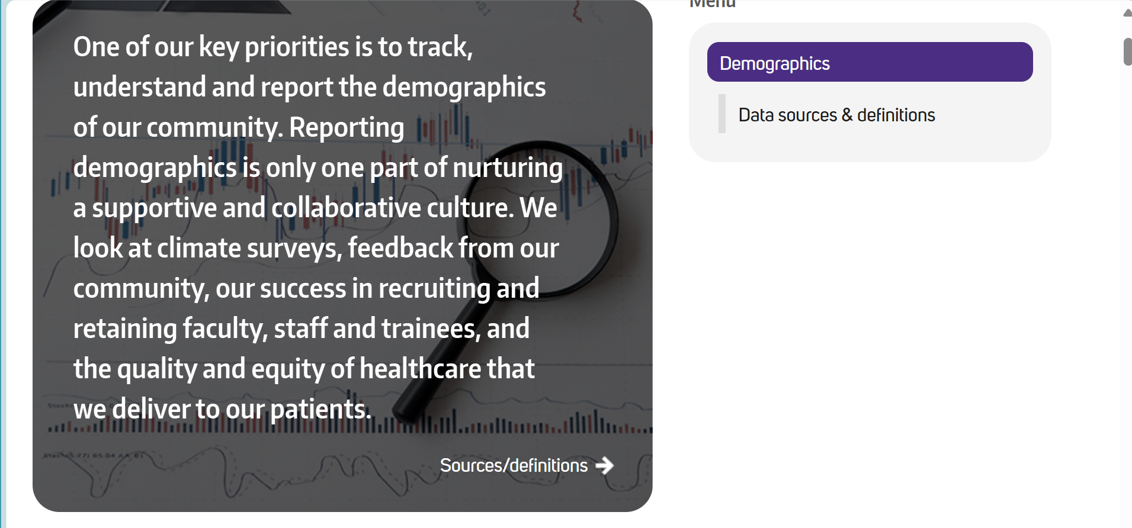
Tracking Demographics
Source: Example above is from UW Medicine, 2024

Slide 24
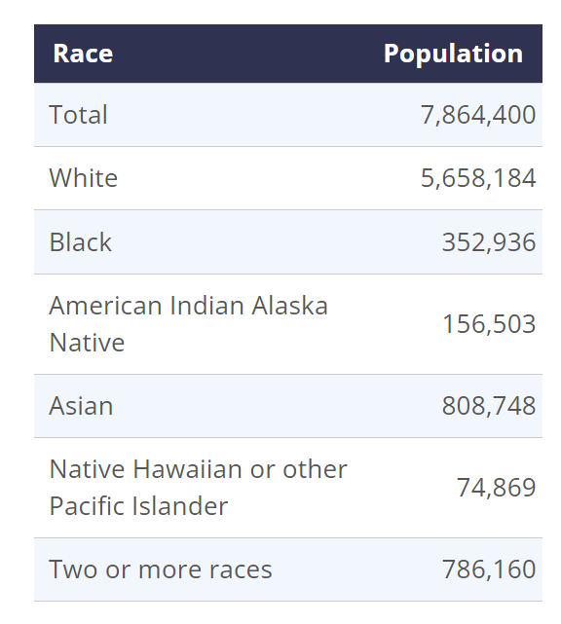
Reaching Target Population in WA State
Your Agency:
How will you find out about the composition of your pt population?
Source: Office of Financial Managemt, WA GOV: https://
ofm.wa.gov/washington-data-research/statewide-data/washington-trends/population-changes/population-race

Slide 25
4
Engagement, Continuous Improvement, and Accountability (12-13)
12
Conduct regular assessments of community health assets and needs and use the results to plan and implement services that respond to the cultural and linguistic diversity of populations in the service area.
Partner with the community to design, implement, and evaluate policies, practices, and services to ensure cultural and linguistic appropriateness.
13
Notes:
Conduct regular assessments of community health assets and needs and use the results to plan and implement services that respond to the cultural and linguistic diversity of populations in the service area. Demographic changes in communities tend to occur every 3-4 years. Consider a periodic/annual review or conduct measures of current community issues to keep agency informed and staff trained and equipped to address presenting concerns. (an innovative example of doing asset assessments is used when the ROSC approach is used.)
Partner with the community to design, implement, and evaluate policies, practices, and services to ensure cultural and linguistic appropriateness. The community is your most precious resource and are experts at what they need, making their input invaluable and necessary for any potential organizational changes. Agencies build credibility when they do effective outreach and recruit community members to participate in advocacy committee meetings.

Slide 26
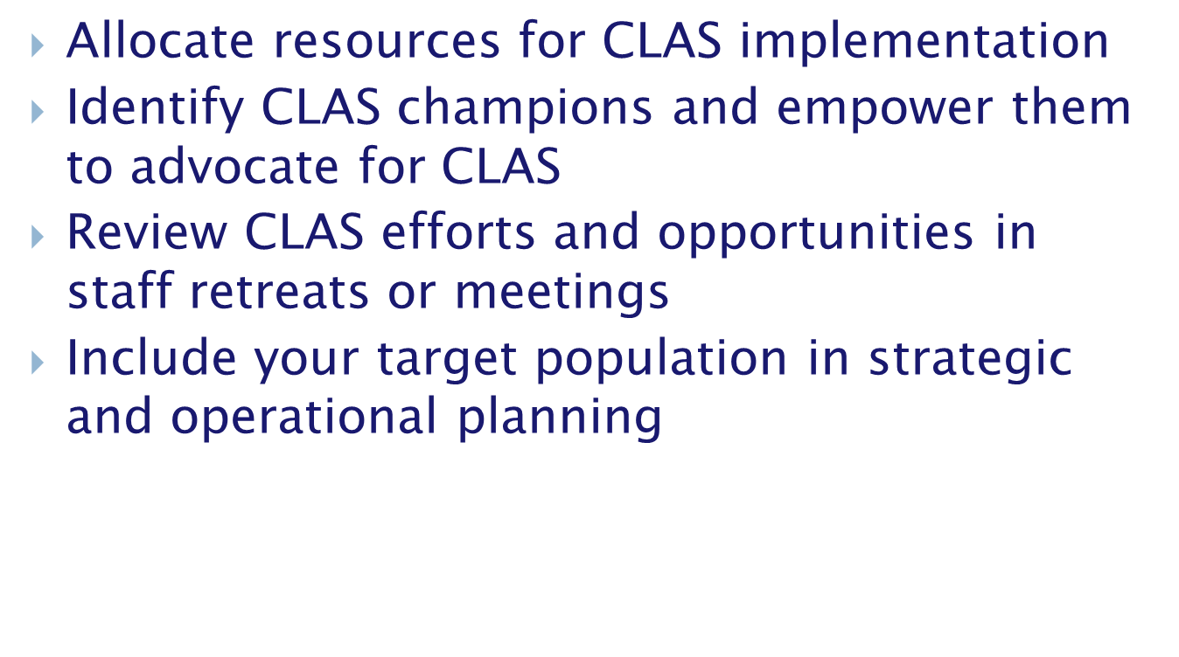
Before you get started, you will need to:

Slide 27
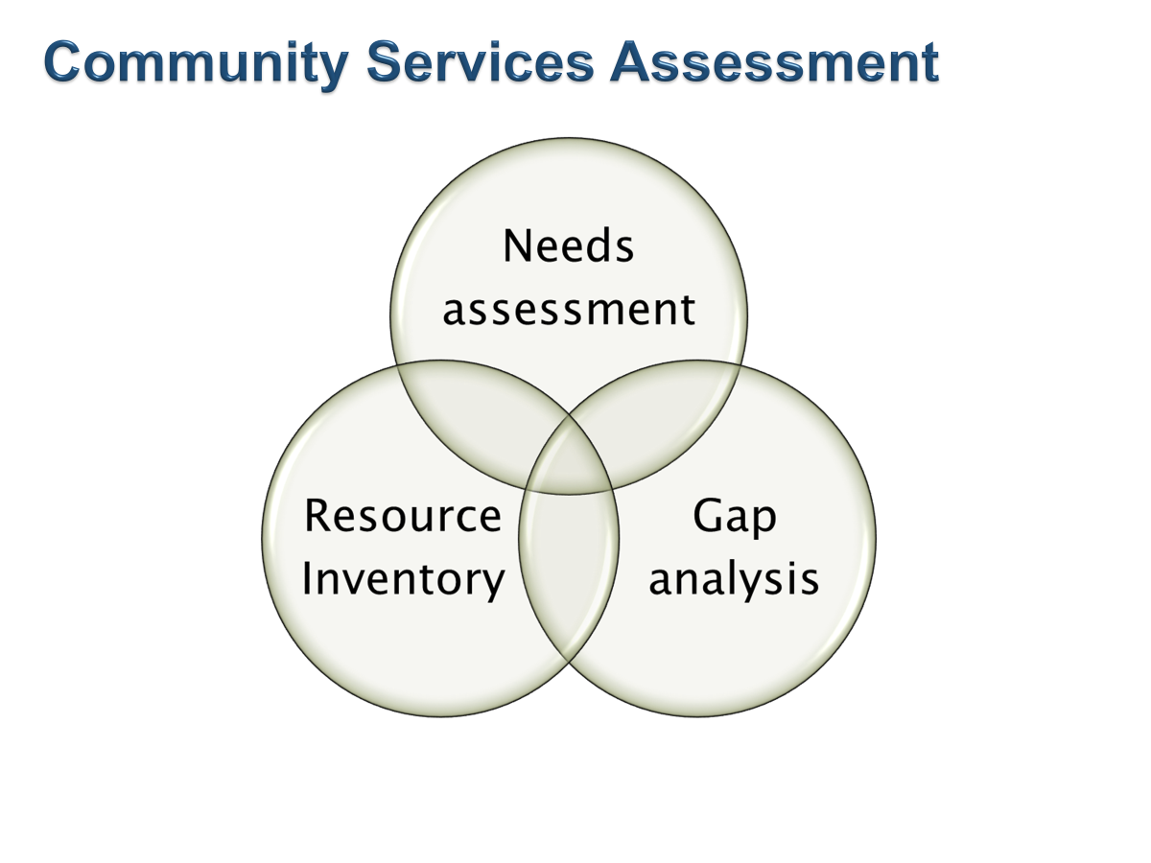
Community Services Assessment

Slide 28
Implementing Change: Some Tools
Source: Wisconsin Department of Health Services, Division of Care and Treatment Services, Bureau of Prevention Treatment and Recovery. CLAS Assessment Planning Tool .

Slide 29
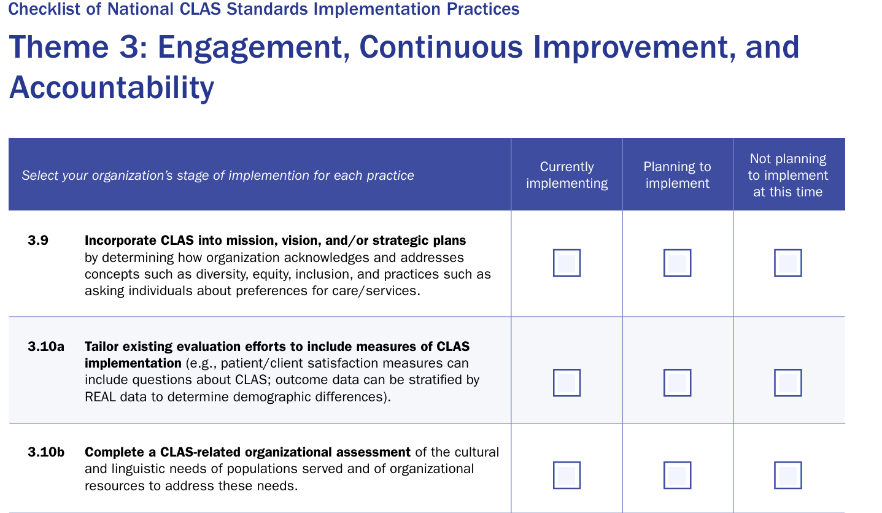
Tracking
Progress: Using the CLAS
Checklist

Slide 30
4
Engagement, Continuous Improvement, and Accountability (14-15)
14
Create conflict and grievance resolution processes that are culturally and linguistically appropriate to identify, prevent, and resolve conflicts or complaints.
Communicate the organization’s progress in implementing and sustaining CLAS to all stakeholders, constituents, and the general public.
15
Notes:
Create conflict and grievance resolution processes that are culturally and linguistically appropriate to identify, prevent, and resolve conflicts or complaints. Organizations should maintain protocols or processes by which consumers can address culturally based grievances, and organizations can confidentially process and address the concerns, and review current organizational and staff protocols to revise and align with culturally appropriate practices.
Communicate the organization’s progress in implementing and sustaining CLAS to all stakeholders, constituents, and the general public. For organizations that have committed to the implementation of the CLAS standards, conduct periodic review of progress reports.

Slide 31
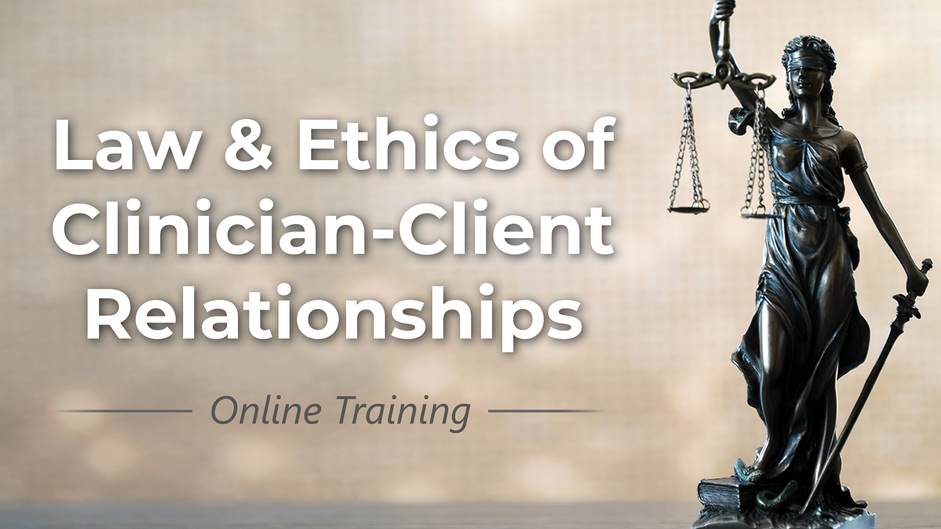
How might we help organizations identify, act on, and resolve grievances?
Notes:
Not an easy process. You can set up grievance procedures galore but it may not be so easy to ensure accountability. Rounding techniques can be used to revisit and have open dialogue (share reference). Also share photo of UW effort…..

Slide 32

Be transparent.
Share findings with leadership and staff.
Act on identified changes.
Revisit findings on a regular basis.
Notes:
Not an easy process. You can set up grievance procedures galore but it may not be so easy to ensure accountability. Rounding techniques can be used to revisit and have open dialogue (share reference). Also share photo of UW effort…..

Slide 33
Q & A and Discussion

Slide 34

THANK YOU!
Contact Info:
Laura Cooley
lcooleyglc@icloud.com
and
Sean Mahoney: smahoney@mhaoforegon.org

Slide 35
NIATx for CLAS Implementation
Contact us for more information about implementing this approach in your agency.

